Slide 1
Web Technology Basics

Slide 2
The WWW

Slide 3
What is the WWW
World Wide Web / WEB
is an information space where documents and other web resources are identified by Uniform Resource Locators (URLs), interlinked by hypertext links, and can be accessed via the Internet
Invented by Tim Berners-Lee in 1989

Slide 4
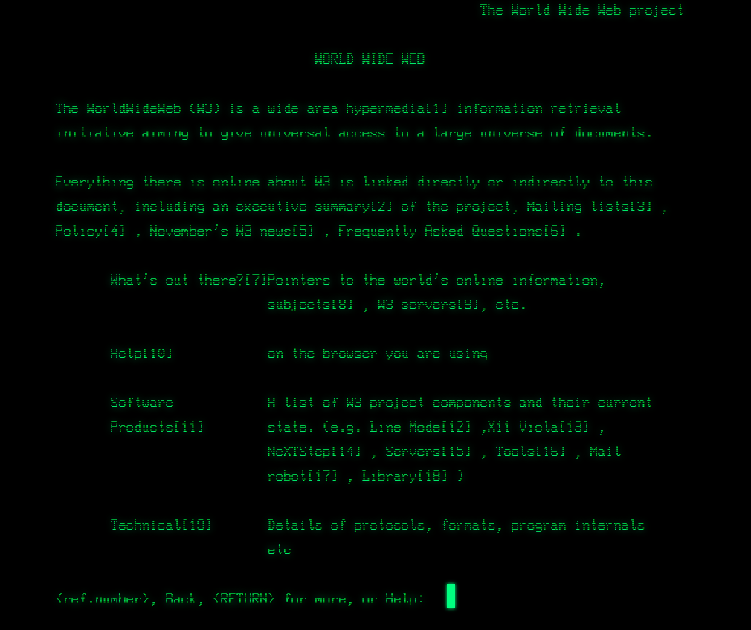
The first website – info.cern.ch

Slide 5
Web Sites and Web Applications

Slide 6
Web Page
Document or information resource that is suitable for the World Wide Web
Can be accessed through a web browser and displayed on a monitor or mobile device
This information is usually in HTML format, and may provide navigation to other web pages via hypertext links
Web pages frequently refer to other resources such as style sheets (CSS), scripts (Javascript) and images into their final presentation

Slide 7
Web Site
Collection of related web pages containing web resources (web pages, images, videos, CSS files, JS files or other digital assets)
Common navigation between web pages
A website is hosted on at least one web server
Accessible via a network (such as the Internet)
All publicly accessible websites collectively constitute the World Wide Web

Slide 8



Web Application
Next level web sites
High interactivity
High accessibility (Cloud)
AJAX, node, web sockets & etc.
Applications are usually broken into logical chunks called "tiers", where every tier is assigned a role
Desktop-like application in the web browser
Web applications on desktop (Windows 8 or later)

Slide 9
Web 1.0, 2.0, 3.0, 4.0

Slide 10
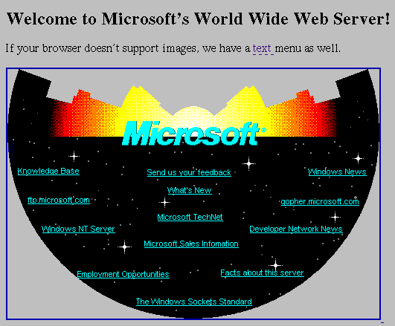
Web 1.0
Identified by web pages being of purely static content
Pages remain the same unless updated by the author of the page
Viewership of pages minimize through time
No engagement, simply boring

Slide 11


Web 2.0
The second stage of development of the World Wide Web, characterized especially by the change from static web pages to dynamic or user-generated content and the growth of social media.

Slide 12
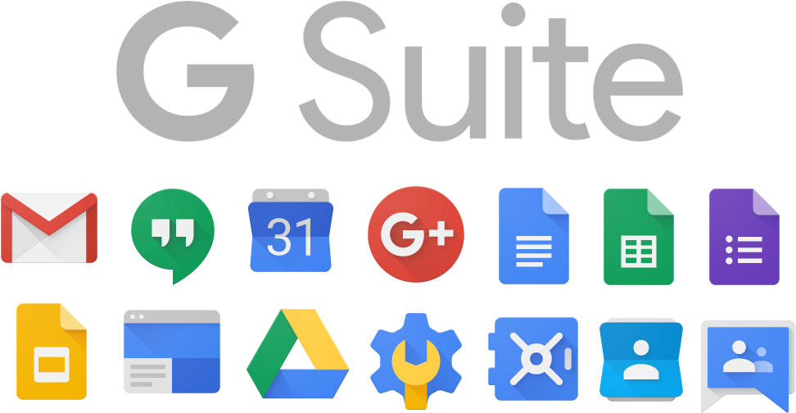
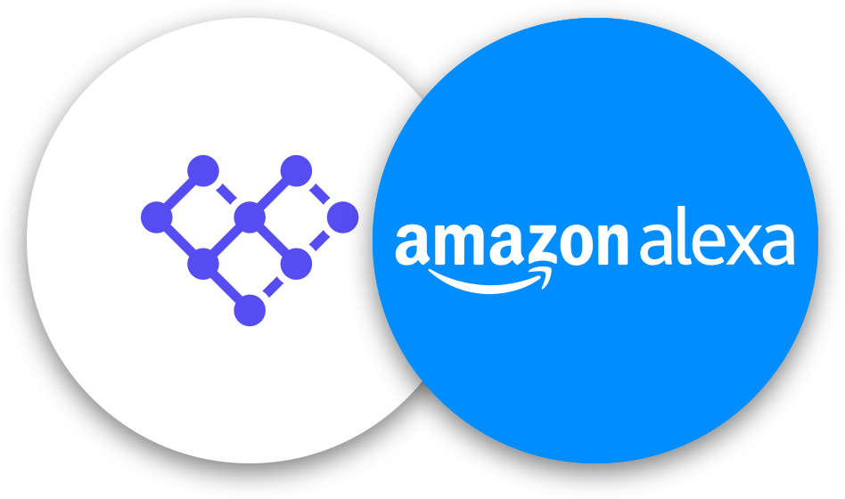

Web 3.0
Used to describe the evolution of the Web as an extension of Web 2.0
In terms of technology cloud-based services have become ubiquitous
A connective intelligence; connecting data, concepts, applications and ultimately people

Slide 13
Web 4.0
Will that be coming along soon?
Web 4.0 is about "the ultra-intelligent electronic agent.“
This agent will "recognize you when you get in front of it because all of your devices are getting a little camera. And with facial recognition, they’ll know it’s you.“
http://bigthink.com/big-think-tv/web-40-the-ultra-intelligent-electronic-agent-is-coming

Slide 14
Web Browsers and Layout Engines

Slide 15
What is a Web Browser
Program designed to enable users to access, retrieve and view documents and other resources from the Web
Main responsibilities:
Bring information resources to the user (issuing requests to the web server and handling any results generated by the request)
Presenting web content (render HTML, CSS, JS)
Capable of executing applications within the same context as the document on view

Slide 16
Layout Engine
Browser component that displays the formatted content on the screen combining:
Marked up content (such as HTML, XML, image files, etc.)
Formatting information (such as CSS, XSL, etc.)
It "paints" on the content area of a window, which is displayed on a monitor or a printer
Typically embedded in web browsers, e-mail clients, on-line help systems or other applications that require the displaying (and editing) of web content
How Browsers Work - http://www.html5rocks.com/en/tutorials/internals/howbrowserswork/

Slide 17



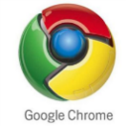
Layout Engines and Web Browsers
Trident-based
Internet Explorer, Netscape, Maxthon, etc.
Gecko-based
Firefox, Netscape, SeaMonkey, etc.
Blink-based
Chrome, Opera, Latest Edge Browser
WebKit-based
Safari, iOS, Maxthon, Chrome (up to v27), etc.
EdgeHTML (fork of Trident)
Spartan (the new IE)
Early Edge Browsers

Slide 18
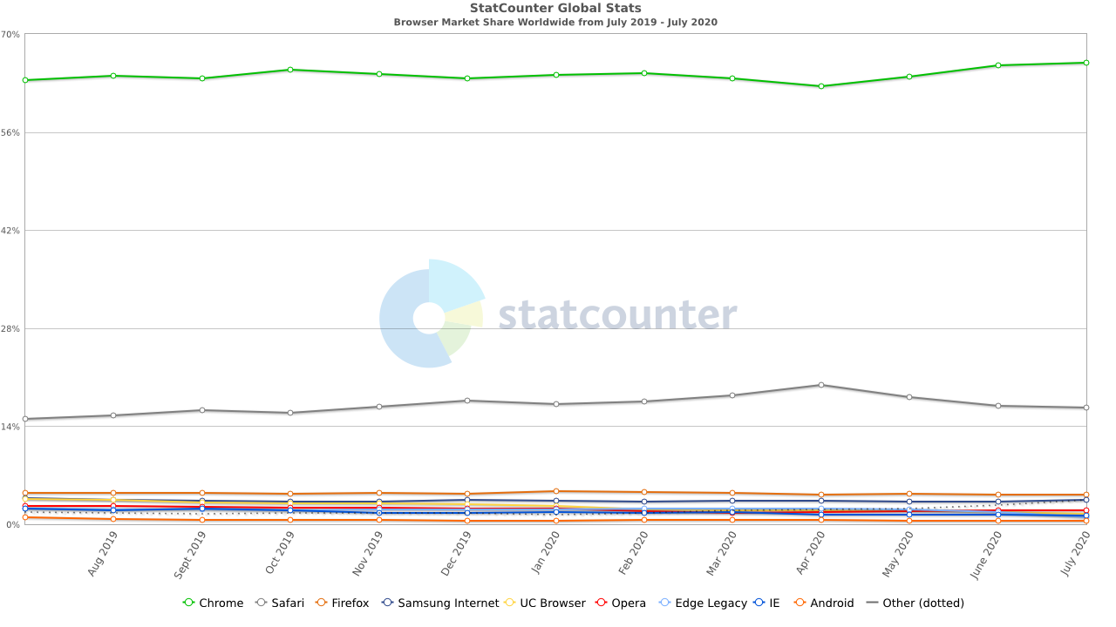
Browser Usage Statistics

Slide 19
Servers

Slide 20
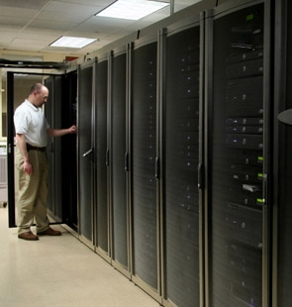
Server
Physical computer (a hardware system) dedicated to running one or more networking services
Servers are placed in collocation centers or data centers
Collocation facilities provide space, power, cooling, and physical security for the server
Servers may be:
Web servers
File servers
Mail servers
Print servers
Database servers

Slide 21
Web Servers

Slide 22
What do Web Servers do?
All physical servers have hardware
The hardware is controlled by the operating system
Web servers are software products that use the operating system to handle web requests
Web servers serve Web content
These requests are redirected to other software products (ASP.NET, PHP, etc.), depending on the web server settings

Slide 23
What Web Servers are used by the Internet?
Apache – a publicly available web server package
This is a free software that can be readily downloaded.
Used to be ranked as the no. 1 web server but recently this is already not the case.
Nginx – another publicly available web server package
This is now considered to be the no. 1 web server used in the Internet.
Microsoft IIS – a commercially available web server that is packaged together with the Microsoft Windows server.
Google Web Server (GWS) – a proprietary web server that is used by Google for its web infrastructure.

Slide 24
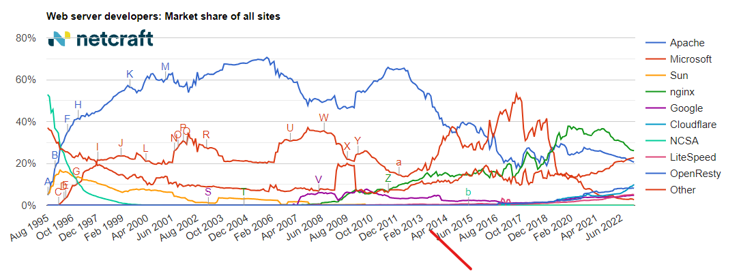
Web Server Statistics

Slide 25
Client-Server Architecture

Slide 26
What is the Client-Server Acrchitecture
This is a type of connection model wherein there are two(2) primary components that exchange information.
Client component
Server component

Slide 27
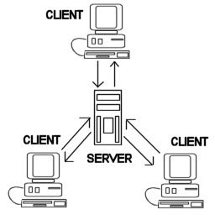
Client Component
Clients –software applications that provide UI (front-end) to access the services at the server
Examples:
Web browsers
HTML5 applications

Slide 28
Server Component
Server – a single machine or cluster of machines that provides web applications (or services) to multiple clients
Examples:
Web server running PHP scripts or ASP.NET pages
IIS based Web server
Services in the cloud

Slide 29
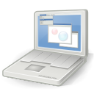
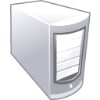


Client-Server connection diagram
Client
Machine
network connection
network connection
Mobile
Client
network connection
Server
Desktop
Client

Slide 30
Other Client-Server Model Examples
FTP server (ftpd) – FTP client (FileZilla)
EMail server (qmail) – email client (Outlook)
SQL Server – SQL Server Management Studio
BitTorrent Tracker – Torrent client (μTorrent)
DNS server (bind) – DNS client (resolver)
DHCP server (wireless router firmware) – DHCP client (mobile phone /Android DHCP client/)
SMB server (Windows) – SMB client (Windows)

Slide 31
3-tier/multi-tier Architectures

Slide 32
3-tier Architecture
The 3-tier architecture consists of the following tiers (layers):
Front-end (client layer)
Client software – provides the UI of the system
Middle tier (business layer)
Server software – provides the core system logic
Implements the business processes / services
Back-end (data layer)
Manages the data of the system (database / cloud)

Slide 33

Data Tier
(Back-End)
Middle Tier
(Business Tier)
Client Tier (Front-End)
Client
Machine
network
network
Mobile
Client
network
Database
Business
Logic
Desktop
Client

Slide 34

Typical Layers of the Middle Tier
The middle tier usually has parts related to the front-end, business logic and back-end:
Presentation Logic
Implements the UI of the application (HTML5, Silverlight, WPF, …)
Business Logic
Implements the core processes / services of the application
Data Access Logic
Implements the data access functionality (usually ORM framework)

Slide 35
End of Lesson

